Slide 1

FACULTY OF ENGINEERING
DEPARTMENT OF COMPUTER ENGINEERING
DEVELOPMENT AND IMPLEMENTATION OF A ROBOTIC APPLICATION FOR HUMAN INTENTION RECOGNITION USING MOTION AND HAND GESTURE
A Final Project Report Submitted in Partial Fulfillment of the Requirements for the Degree of BSc. Computer Engineering
PRESENTED BY:
ELEANA OSEI OWUSU — 4121230024
JOEL NII ADJETEY AHULU — 4121230020
SUPERVISOR: MR. MICHEAL XENYA
GHANA COMMUNICATION TECHNOLOGY UNIVERSITY

Slide 2
PRESENTATION OUTLINE
Introduction Problem Statement Objectives of Study Significance of Study Research Gaps Literature Review Methodology System Architecture | Hardware and Software Components Dataset Preparation and Gesture Recognition SLAM Testing and Results Conclusion Future works References

Slide 3
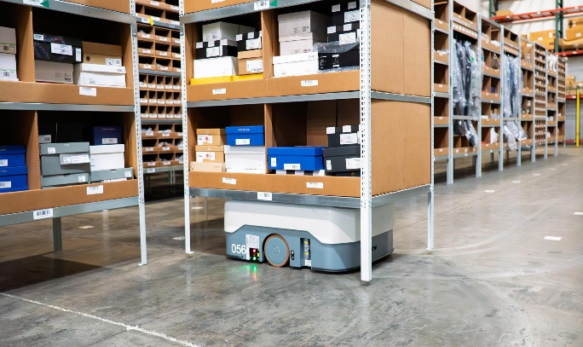
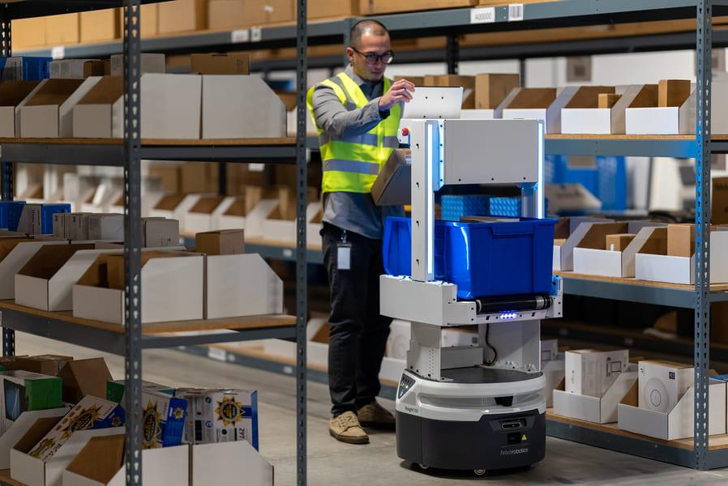
INTRODUCTION
Human–Robot Interaction (HRI) enables robots to understand and respond to human actions.
Gestures and body movements provide natural, contactless control.
Vision-based systems can require high computing power..
Edge computing supports real-time processing on low-power robots.
This project combines intention recognition, environmental awareness, and navigation.
Figure 1: Autonomous Mobile Robot Performing Navigation Tasks
Figure 2: Human Interaction with an Autonomous Mobile Robot Interface

Slide 4
Problem Statement
• High-Power Compute & Cloud Latency: Offboard cloud vision introduces unpredictable latency (>200 ms) and connection dropouts, violating real-time robotic safety thresholds (Tsitos et al., 2022).
• Spatial Domain Shift Across Distances: Models evaluating raw anatomical pixel coordinates suffer severe classification degradation as operator distance varies (1.0m to 2.5m) due to optical perspective scaling.
• Ungrounded & Spatial-Blind Execution: Executing recognized gestures blindly without continuous 360° laser mapping presents acute collision hazards in populated indoor workspaces.
• Collaborative Safety Requirements: International standards (ISO 15066:2016) mandate speed and separation monitoring, requiring guaranteed deterministic halting distances (<0.45m).

Slide 5
OBJECTIVES
.
General Objective:
To design, implement and evaluate an edge-based real-time human intention recognition system integrating hand gestures and autonomous navigation using ROS 2.
Specific Objectives:
• To design and implement an edge-optimized vision pipeline using 19 scale-invariant geometric hand features.
• To construct and balance a custom 6,000-sample gesture dataset captured directly through the robot camera.
• To develop an LSTM recurrent model for short-horizon human trajectory prediction.
• To implement a deterministic supervisory decision node (brain_node) with rolling consensus and visual servoing.
• To configure and validate LiDAR SLAM and Nav2 autonomous navigation for collision-free trajectory execution.
• To quantitatively evaluate latency budgets (<150 ms), classification accuracy, and real-time physical throughput.

Slide 6
LITERATURE REVIEW
Ref / Year | Author(s) | Topic | Objectives | Methodology | Identified Gaps
[1] 2022 | Tsitos et al. | Real-time Feasibility of a Human Intention Method Evaluated Through a Competitive Human-Robot Reaching Game | Predict human intention in real time using a single RGB-D camera. | OpenPose, RGB-D camera, ML models, ROS, UR3 robot. | Stationary UR3 manipulator arm without mobile base navigation or explicit touchless gesture command channel.
[2] 2022 | Mahmud et al. | 3D Gesture Recognition and Adaptation for Human–Robot Interaction | Recognize 3D gestures for robot control. | Kinect, HMM, SVM, CNN, robot navigation. | Restricted to proprietary high-power Kinect sensor; navigation evaluated only in simulation without physical latency or wheel slip.
[3] 2023 | Yang et al. / Li et al. | Safe and Efficient Motion Planning for Material Transportation Robots Considering Intention Prediction of Obstacles | Predict obstacle intentions for safe navigation. | Object detection, ReLU intention model, Nav2, ROS2. | Tested in simulation (Isaac Sim) for obstacle yielding; lacks touchless human supervisory gesture directives.

Slide 7
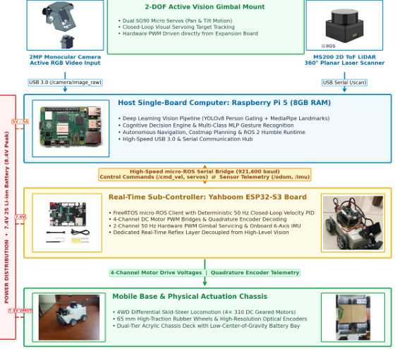
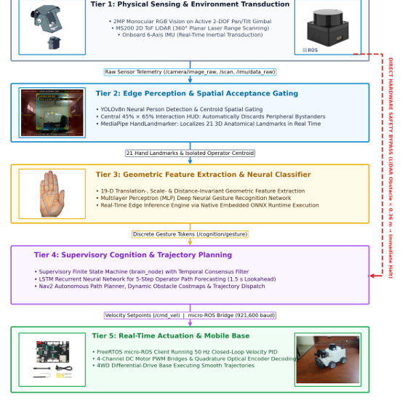
SYSTEM ARCHITECTURE
Figure 3: Hardware Architecture and Signal Distribution
Figure 4: System Architecture

Slide 8
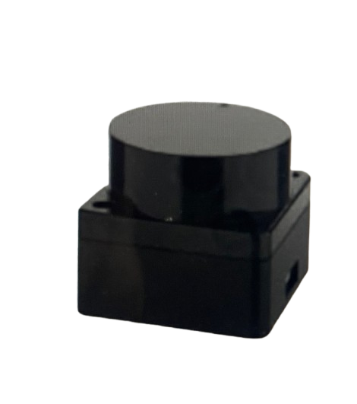
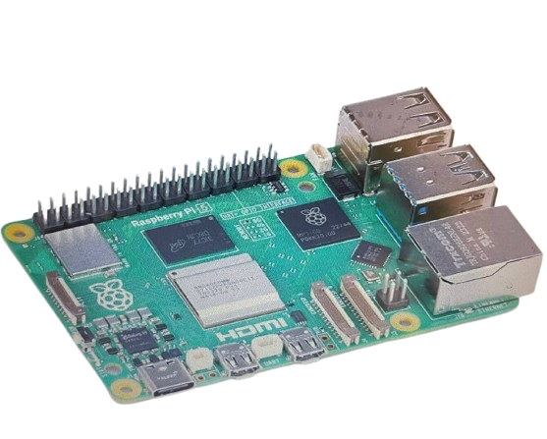
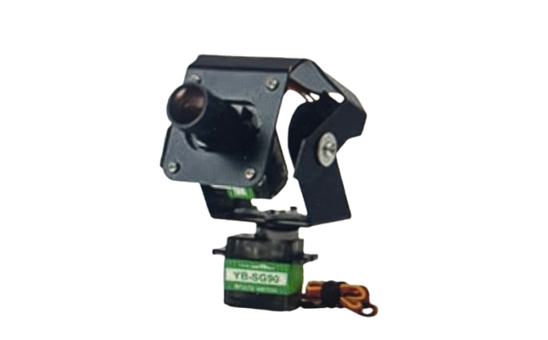
HARDWARE COMPONENTS
Figure 5: Raspberry Pi 5 (8GB RAM)
Main edge SBC processing YOLOv8, MediaPipe, 19-D MLP, and SLAM/Nav2 directly onboard at 28.4 FPS.
Figure 6: USB Monocular Camera
Captures 640x480 RGB frames at 30 FPS for gesture classification and active gimbal tracking.
Figure 7: MS200 2D Planar LiDAR
Provides 360° laser scans at 10 Hz up to 12m for SLAM Toolbox and triggers the 0.36m ISO 15066 safety halt.

Slide 9
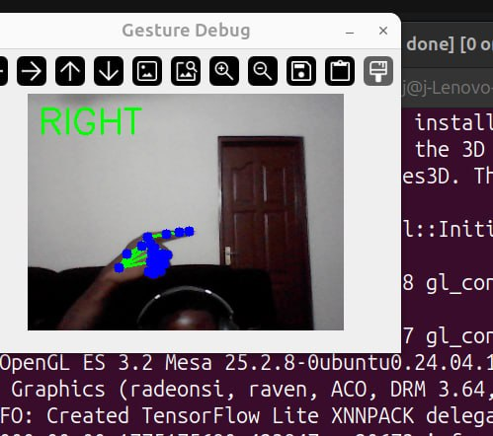
DATASET PREPARATION AND GESTURE RECOGNITION PIPELINE
6,000 samples collected from the robot’s own camera.
6 gesture classes: Stop, Go, Left, Right, Back, Follow.
Balanced dataset: 1,000 samples per gesture.
MediaPipe extracts 21 hand landmarks
Landmarks are converted into 19 normalized geometric features
MLP classifier recognizes the six gestures..
Figure 11:Live System Demonstration: The detected gesture is classified and displayed in real time.

Slide 10
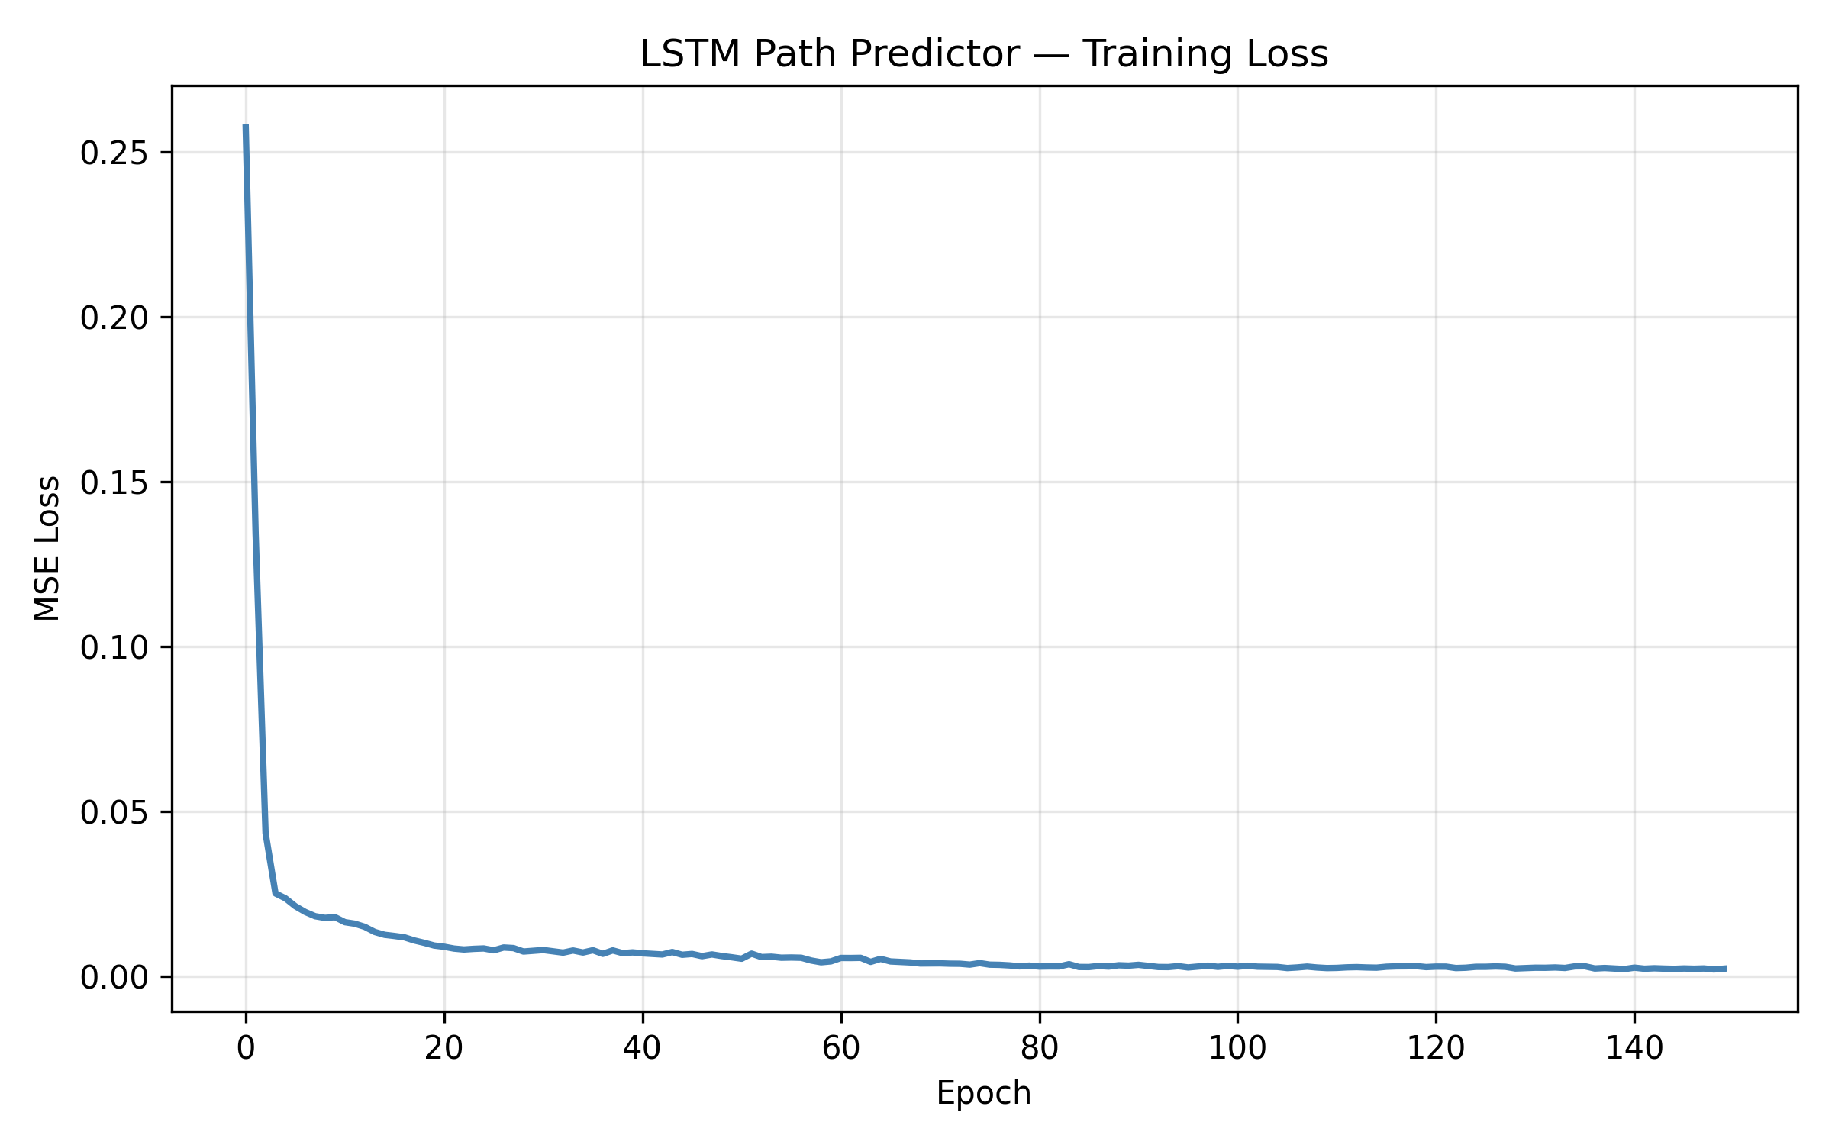
HUMAN MOVEMENT PREDICTION(LSTM)
Uses MediaPipe Pose landmarks to track human movement.
LSTM predicts the operator’s next movement direction.
Uses past movement patterns to anticipate future motion.
Helps the robot respond proactively instead of reactively.
Achieved 25.8 px ADE and 32.4 px FDE.
Figure 13: LSTM Path Predictor Training Loss & Validation Convergence (ADE: 25.8 px, FDE: 32.4 px)

Slide 11

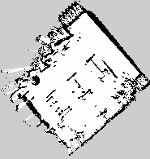
SLAM MAPPING AND LOCALISATION
SLAM Toolbox creates a 2D map using LiDAR and wheel odometry.
The environment is represented as an occupancy grid.
Nav2 enables point-to-point autonomous navigation.
AMCL localizes the robot on the generated map.
Costmaps help the robot avoid unexpected obstacles
Figure 14: Initial SLAM Run — Hourglass Rotational Drift Defect (Unsynchronized IMU Yaw)
Figure 15: Final SLAM Run — Clean 5cm Metric Occupancy Grid Map (EKF Restamping Fix)

Slide 12
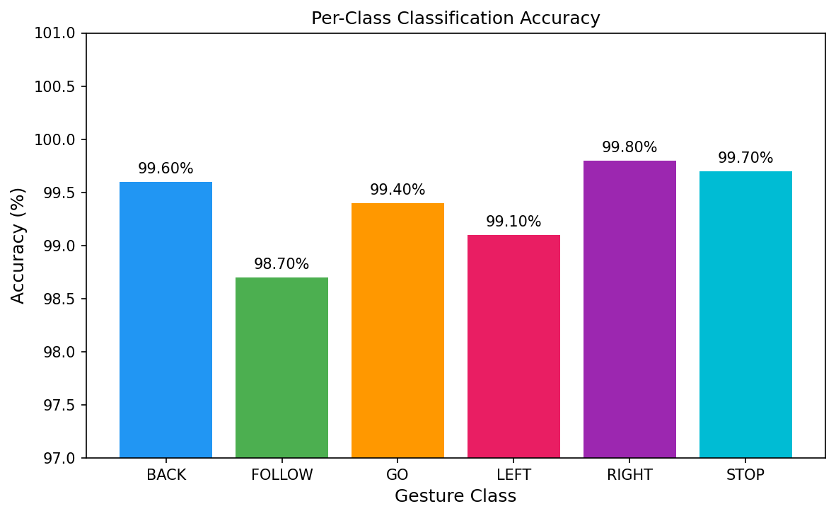
TESTING AND RESULTS
Gesture Recognition Physical Trial Results
Gesture | Total Trials | Successful Trials | Observed Accuracy (%)
Stop | 30 | 27 | 90.0%
Go | 30 | 29 | 96.7%
Follow | 30 | 28 | 93.3%
Left | 30 | 30 | 100.0%
Right | 30 | 30 | 100.0%
Back | 30 | 30 | 100.0%
Aggregate | 180 | 174 | 96.67%
Figure 16: Per-Class Classification Accuracy of the Trained MLP Gesture Model

Slide 13
TESTING AND RESULTS
Movement Recognition Test Results
Movement Class | Observed Kinematic Behavior | Result
Approaching | Rapid expansion of bounding box area with stable center | Successfully Recognized
Moving Away | Continuous contraction of bounding box area with stable center | Successfully Recognized
Moving Left | Persistent leftward centroid translation across frames | Successfully Recognized
Moving Right | Persistent rightward centroid translation across frames | Successfully Recognized
Stationary | Centroid displacement within noise threshold (±4 px) | Successfully Recognized

Slide 14
CONCLUSION AND FUTURE WORKS
Conclusion
Future works
99.38% gesture recognition accuracy.
96.67% physical trial accuracy.
Successful human movement prediction.
ROS 2 integration achieved.
SLAM and Nav2 validated
Real-time edge operation achieved
Safe obstacle detection implemented
Multi-waypoint autonomous navigation.
Proactive human-aware navigation.
Follow-to-Map exploration.
NPU acceleration for AI tasks.
Improved gimbal–chassis control
Multi-sensor safety detection
Larger and more diverse testing.

Slide 15
REFERENCES
[1] D. Tsitos et al., “Real-Time Feasibility of a Human Intention Prediction Method Evaluated Through a Competitive Human–Robot Reaching Game,” IEEE Robotics and Automation Letters, vol. 7, no. 4, pp. 10034–10041, Oct. 2022.
[2] J. A. Mahmud, B. C. Das, J. Shin, K. M. Hasib, R. Sadik, and M. F. Mridha, “3D Gesture Recognition and Adaptation for Human–Robot Interaction,” IEEE Access, vol. 10, pp. 116485–116507, 2022.
[3] G. Yang, S. Wang, H. Okamura, Y. Ueda, T. Yasui, T. Yamada, Y. Miyazawa, S. Yoshida, Y. Inada, S. Ino, K. Okuhata, and Y. Mizobuchi, “Safe and Efficient Motion Planning for Material Transportation Robots Considering Intention Prediction of Obstacles,” in Proc. IEEE Int. Conf. Mechatronics Autom. (ICMA), Harbin, China, Aug. 2023, pp. 1179–1184.
Thank You — Questions & Discussion
[ Transition to Live Physical Hardware Demonstration ]

